Slide 1

Theory, Preprocessing, and Artifact Identification
Iowa BrainHack
2 July 2021

Slide 2

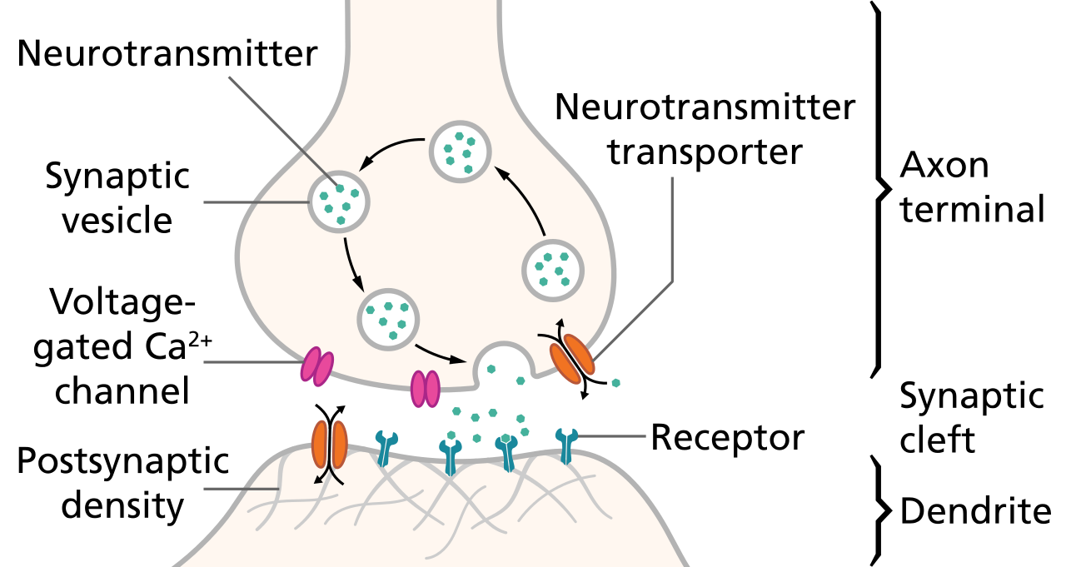
And that’s how the neuron do.
Notes:
Exists a voltage difference across cell membrane and depolarization leads to a spike
EPSPs are represented most in LFP
APs are NOT what’s being measured by EEG. This is NOT single cell recording

Slide 3
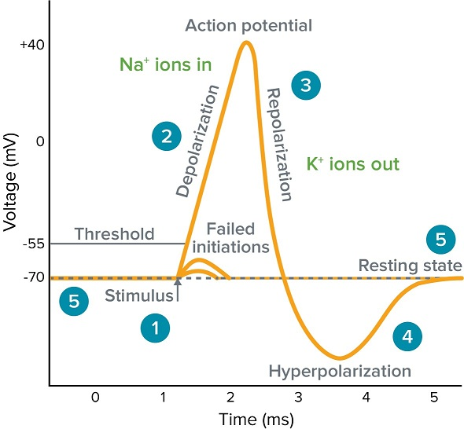

Slide 4
The Local Field Potential (LFP)
What we are measuring
Extracellular sum of currents resulting from neuronal processes
Created mostly from excitatory/inhibitory extracellular currents
Any excitable membrane contributes
Notes:
AP is linked via the post-synaptic potential to the LFP
When AP arrives at apical dendrite, positive ions Na and Ca flow into the cell
Causes a local current ‘sink’ outside of the cell because it has become more negatively charged
sink (- polarity current) is balanced by an extracellular ‘source’
typically propagates down the axon of the neuron
Relative location of source and sink creates a dipole or higher order n-pole
Dipole is oriented in a certain way which is partially dictated by neuronal shape because the source propagates down the axon
Pyramidal neurons create large dipoles and make up a substantial portion of the LFP
Dipole is the fundamental quantity of electricity that is measurable
EPSPs contribute more bc initial current sink from + ions entering postsyn cell; presyn terminal and postsyn cell are positively charged which produces an additional current sink on the outside
LFP in sum is superposition of all ionic processes
Travels via volume conduction and diminishes exponentially
When doing scalp recordings, the signal will emerge from the noise through repetition. This is what an ERP is.

Slide 5
What does EEG measure?
“Dipolar electrical sum potentials of large swaths of simultaneous active (sub)cortical neurons oriented radially to the scalp.” – Dr. Jan Wessel, 2021
Electrical activity in the brain propagates via volume conduction
What other things, besides the activity of neurons, might scalp EEG pick up?
Inverse problem – at each electrode, you don’t know where in the brain the signal originates
Therefore, EEG has poor spatial resolution
Notes:
Volume conduction – electrical fields produced by the dipoles comprising local field potentials spreads through a conductive medium (brain), even if impeded by scalp, CSF, skin
Strength of electrical field depends on
How strong current sink and source underlying change in LFP is
Alignment of dipoles
Synchrony of dipoles
Need multiple neurons in the same area of cortex to have synchronous changes in LFP and neurons must be oriented correctly
The activity of multiple neurons creates the LFP dipole, which is measured

Slide 6
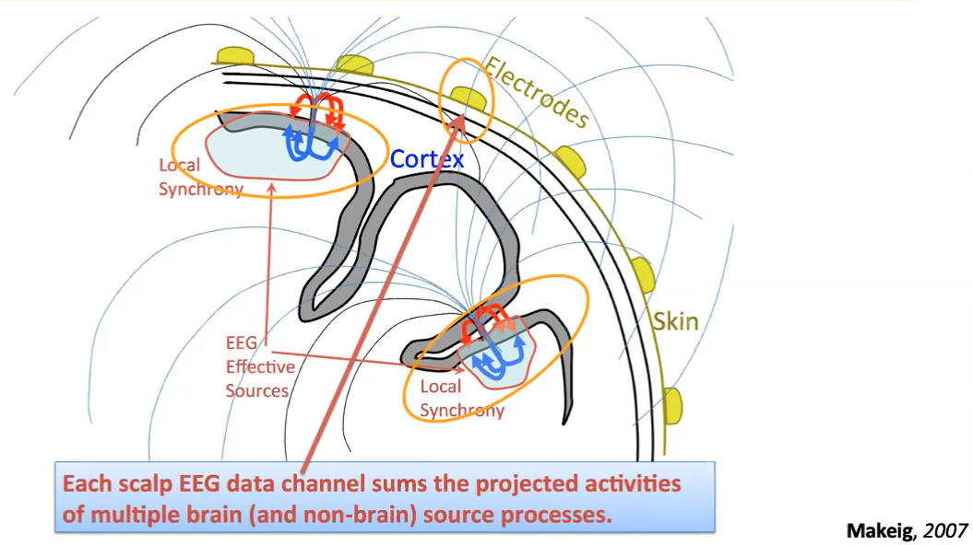
Slide taken from Dr. Jan Wessel’s Neural Field Potentials course
Notes:
Implication of inverse problem - Infinite number of configurations of dipoles that could result in some recorded EEG activity
Discuss orientation of dipoles, fields
Can’t pick up all signals (not all are strong enough)
Determinants of inclusion in LFP: synchrony of firing of a large population of neurons and alignment of neurons (affects the location of the sink/source of the dipole) and alignment of dipoles (which can depend on other things)

Slide 7
Dipolar alignment depends on sulcal topography
Open field
Often from pyramidal neurons
Large distance between source and sink
Stronger dipoles
Closed field
Often from thalamocortical cells
Simultaneous activation of dendrites, but in different directions
Weaker dipoles

Slide 8
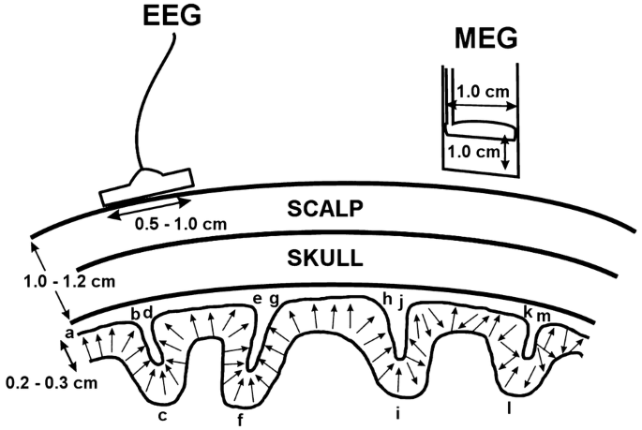







(Nunez, Nunez, & Srinivasan; 2019)
Notes:
Before moving on, I’d like to clear up that patch clamping or voltage clamping is NOT an LFP

Slide 9
What the heck does this have to do with matrix manipulation??
EEG data is stored in matrices
Channels are rows and sampling points are columns
Typically, 64 rows X LOTS of columns
Channel location data are stored in a cell array

Slide 10
Data Preprocessing

Slide 11
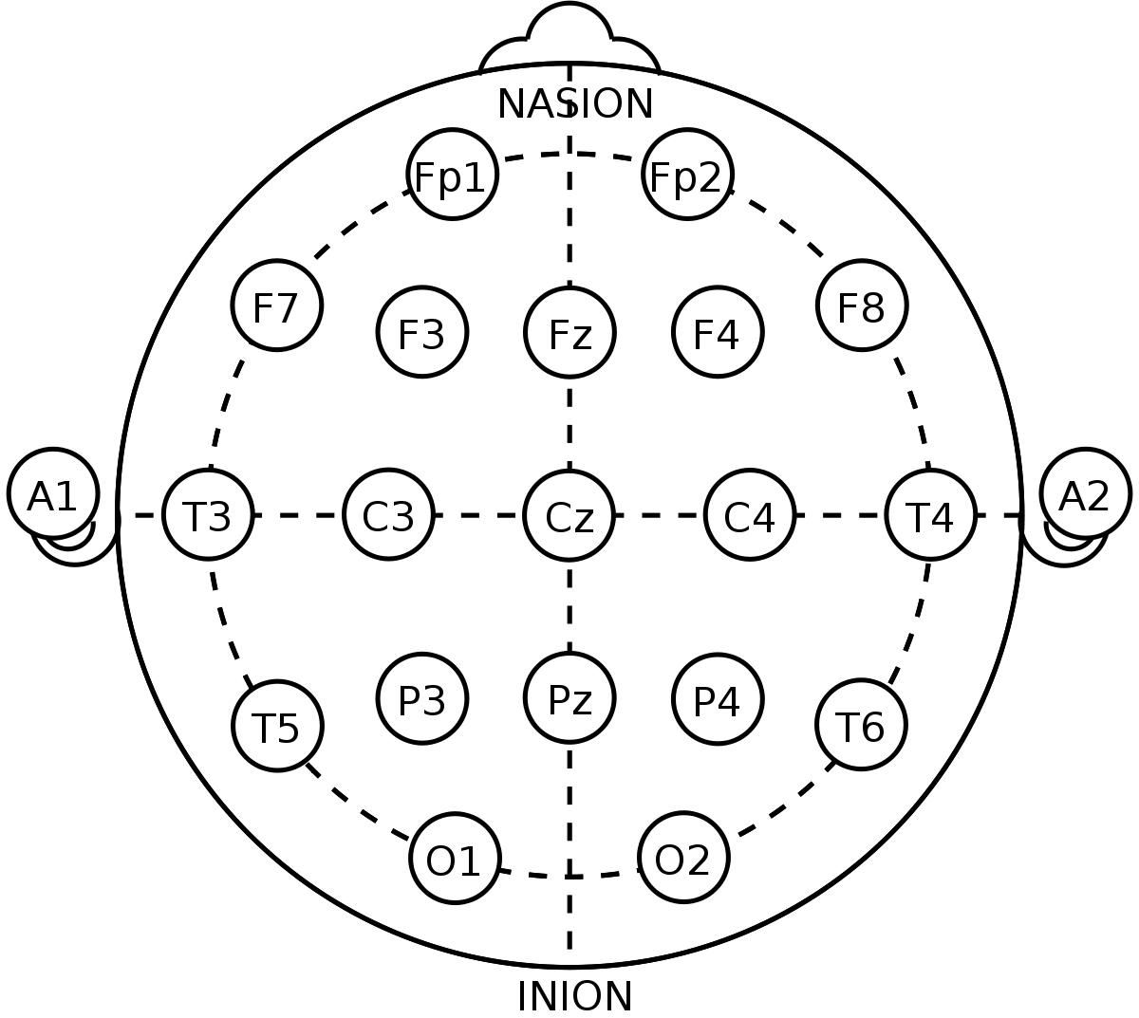
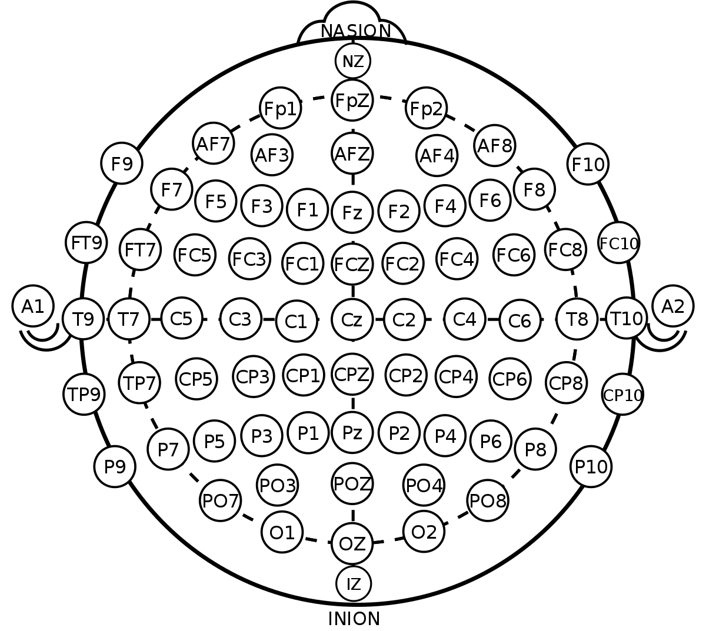
Notes:
Original 10-20 system for clinical purposes
Nasion – bridge of nose
Inion – bony protrusion at back of head
Distance from tip of ears
Fp is frontopolar
Need reference electrodes at mastoids or earlobes (finding electrically neutral site which doesn’t actually exist)

Slide 12
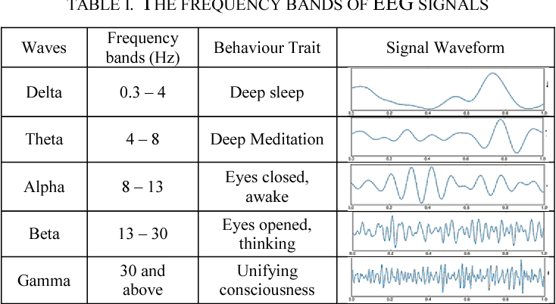

Slide 13
Preproccessing
Preprocessing removes non-brain signals (aka, noise in the data)
EEG data contains artifacts
Physiological and non-physiological
Stereotypic and non-stereotypic
Type of artifact affects how the artifact is removed

Slide 14
Categories of Artifacts
Stereotypical Artifacts
Non-stereotypical Artifacts
Recurrent
Blinks
Saccades
Some electrode artifacts
Line noise
Intermittent
EMG artifacts
Sweat artifacts
Some electrode artifacts
Jaw clenching/chewing
Notes:
https://www.slideshare.net/SudhakarMarella/eeg-artifacts-15175461 shows great examples of artifacts with detailed explanations for those interested
Line noise – random fluctuations of an electrical signal along a standard AC current, from electronics

Slide 15
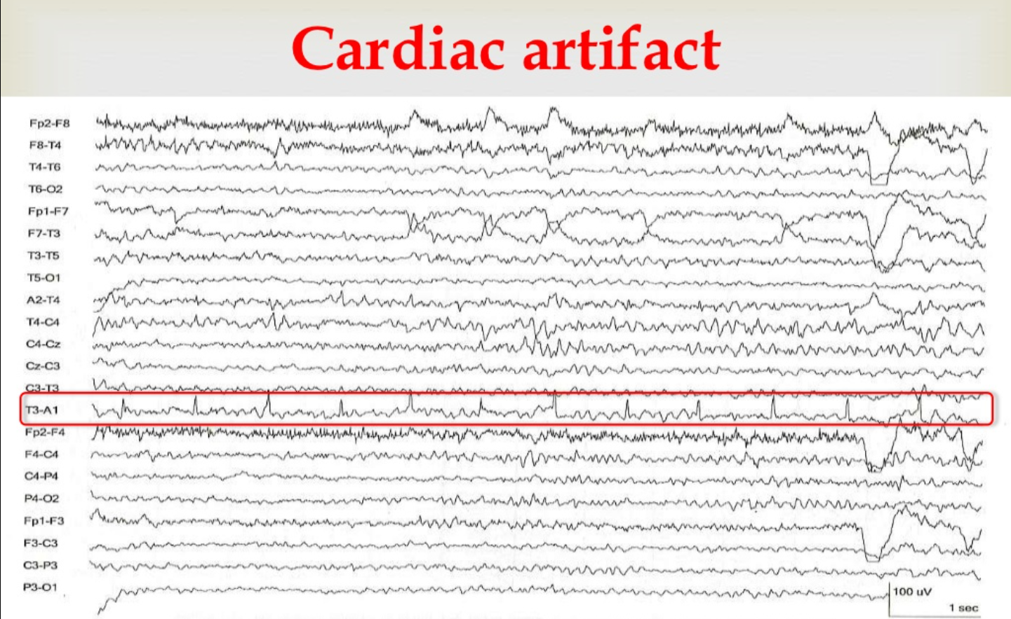

Slide 16
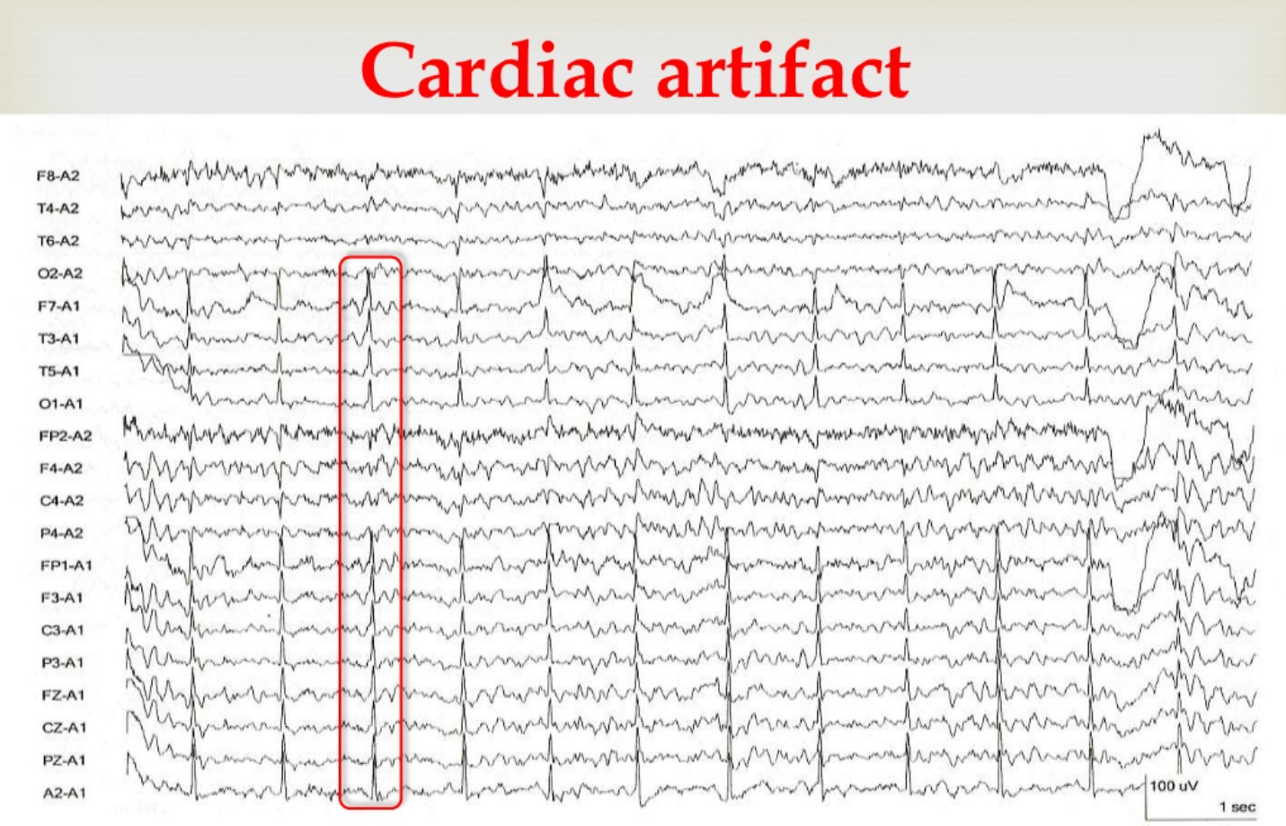

Slide 17
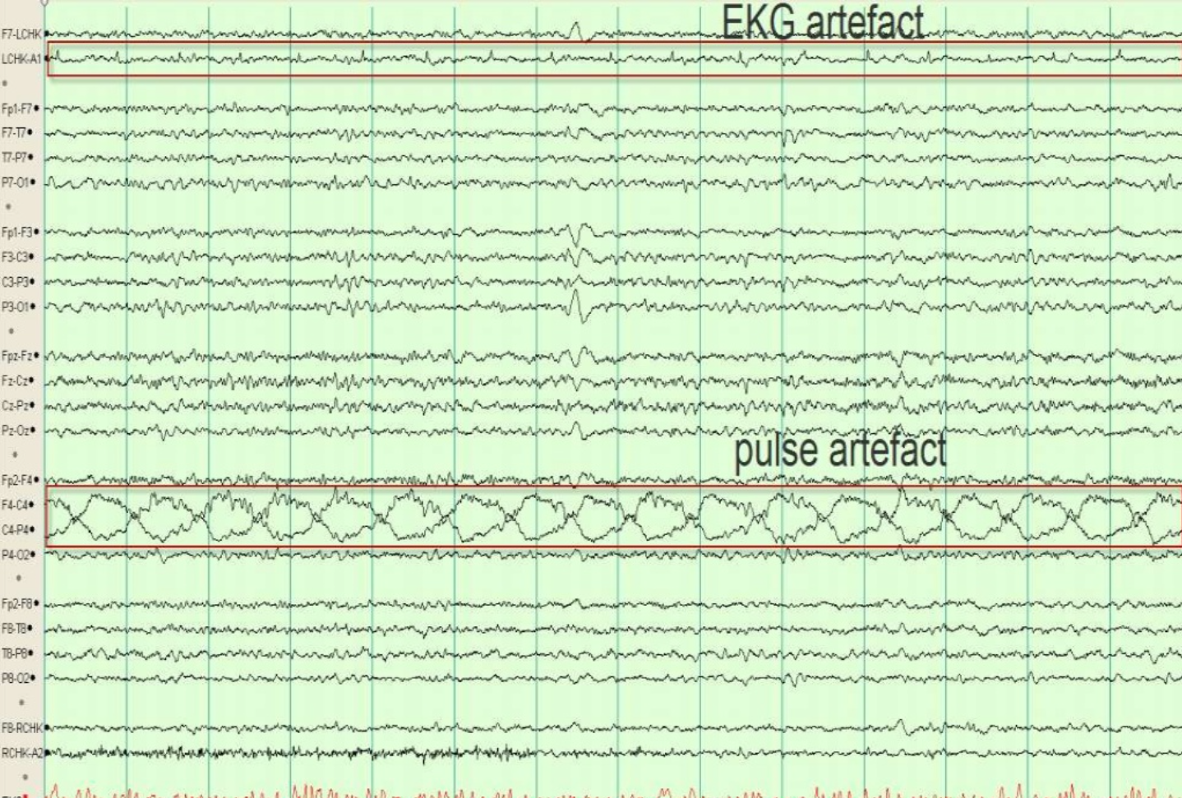

Slide 18
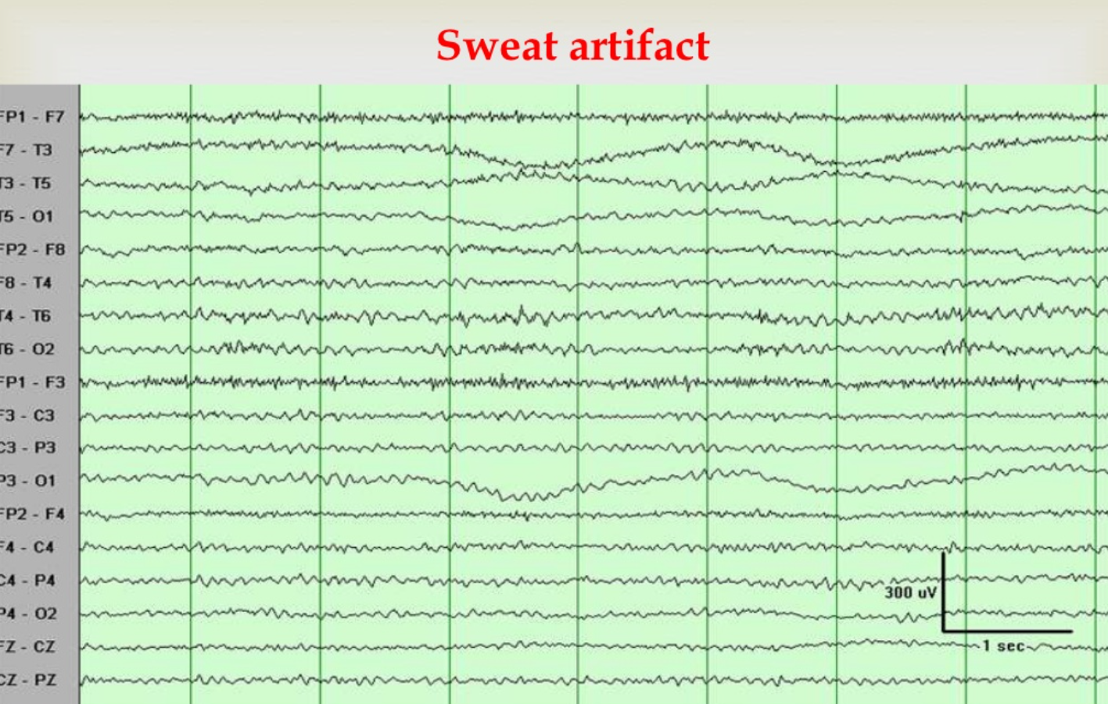

Slide 19
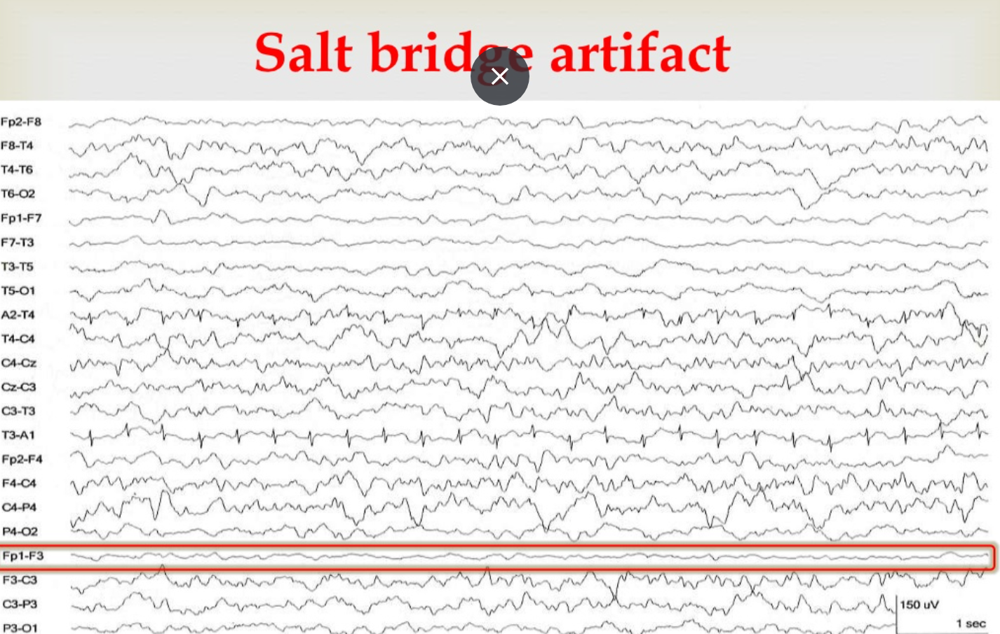
Notes:
Occurs with smearing of electrolyte gel between two electrodes or by applying too much electrolyte gel creating a short circuit between electrodes

Slide 20
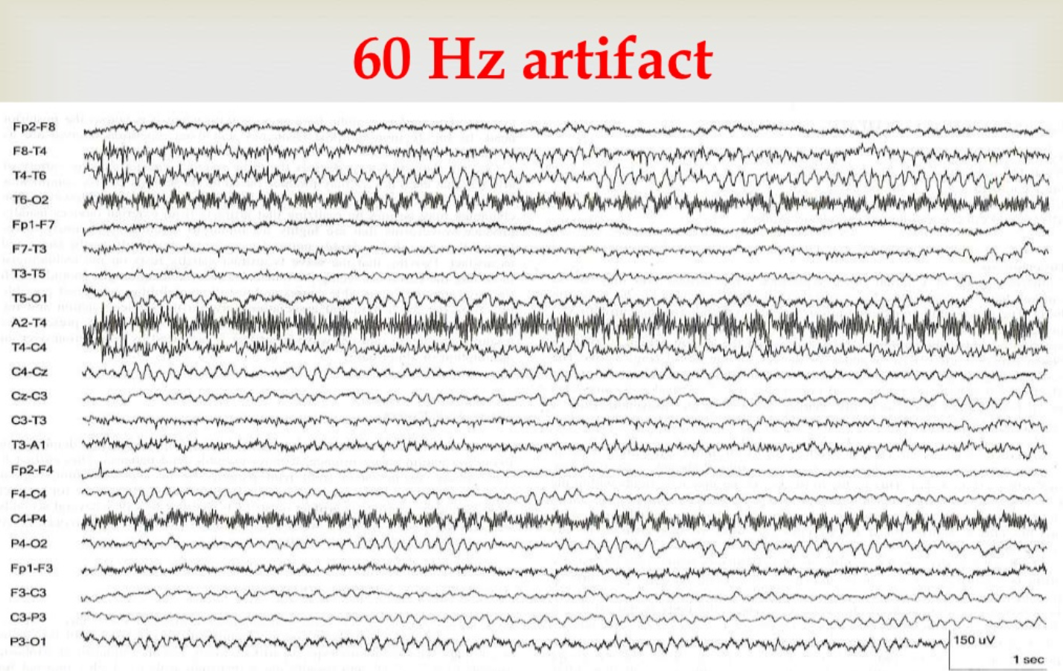
Notes:
Can get rid of stuff like this with a filter

Slide 21
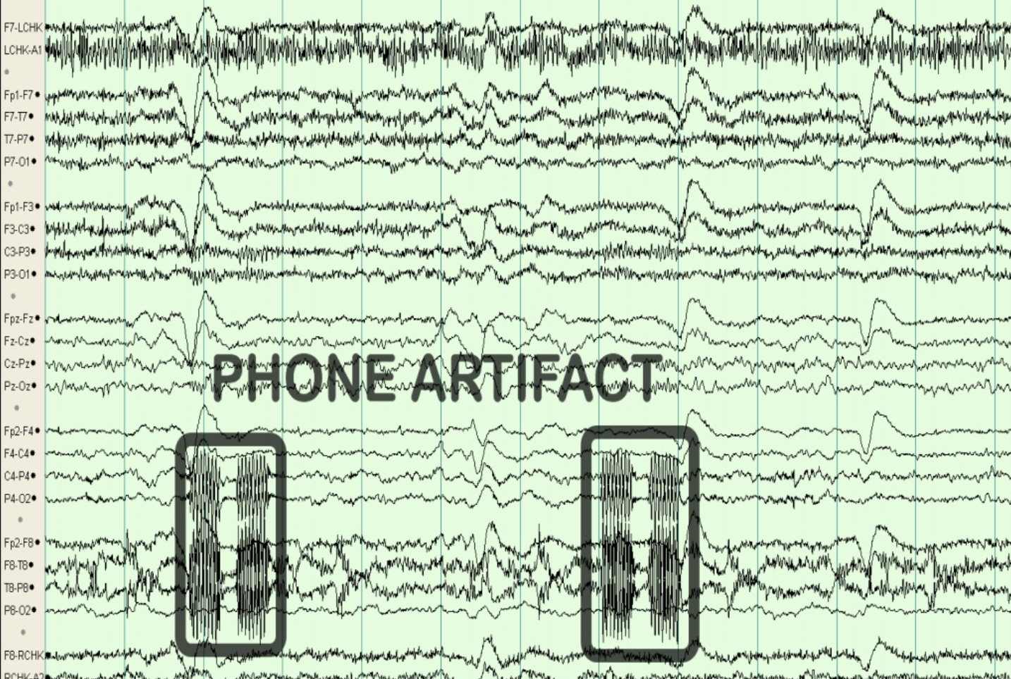

Slide 22
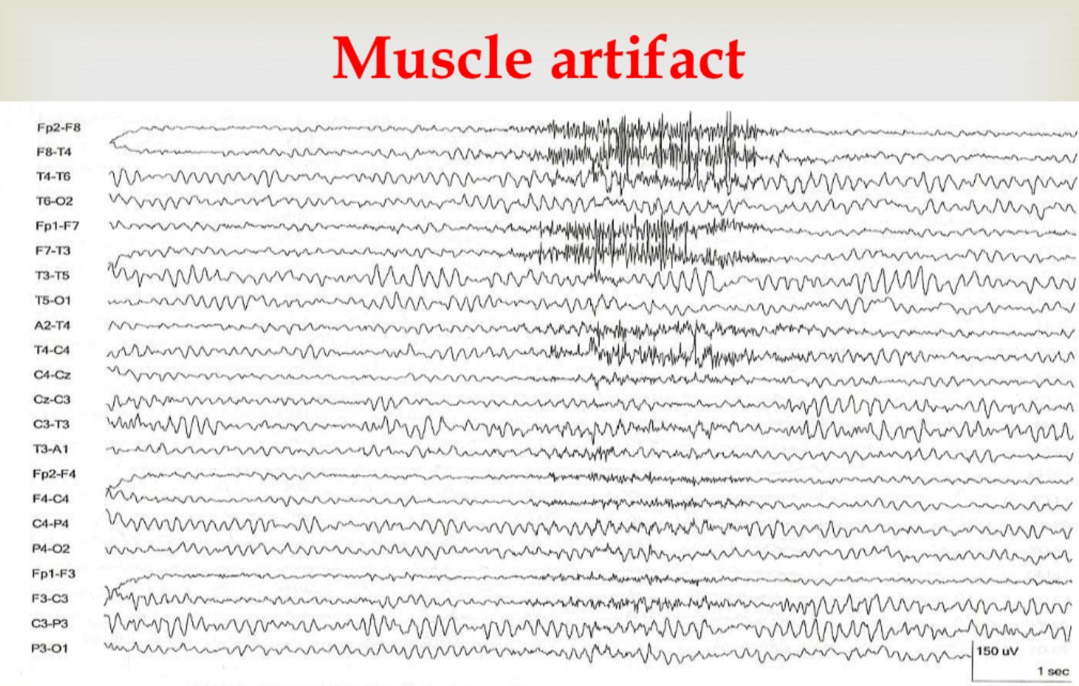

Slide 23
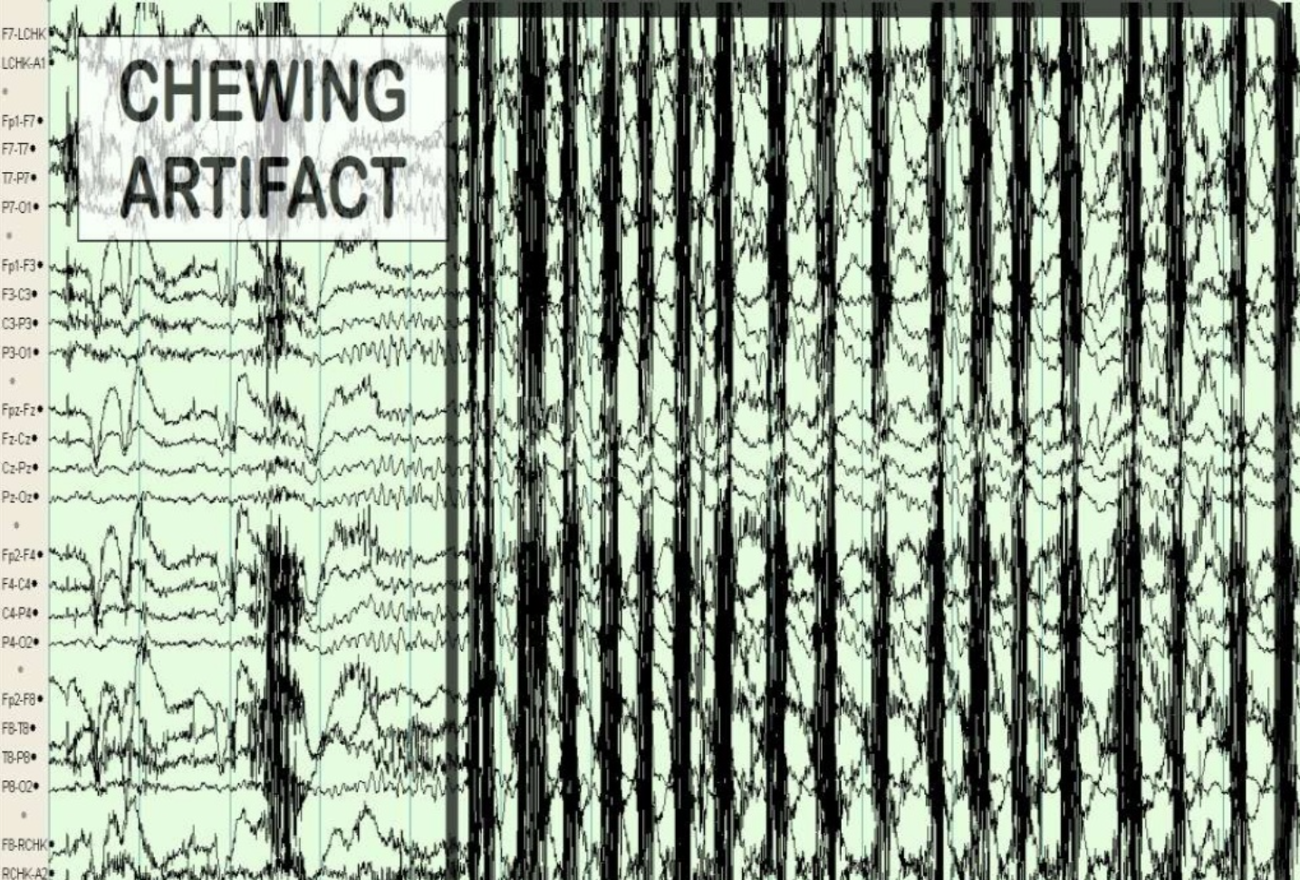

Slide 24
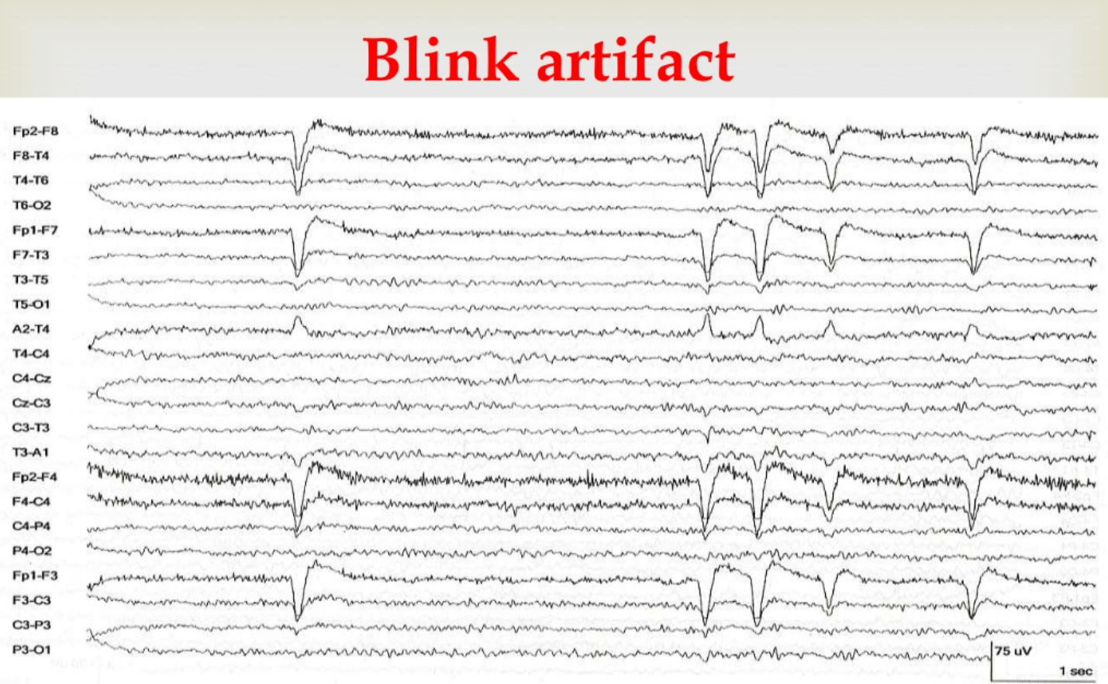

Slide 25
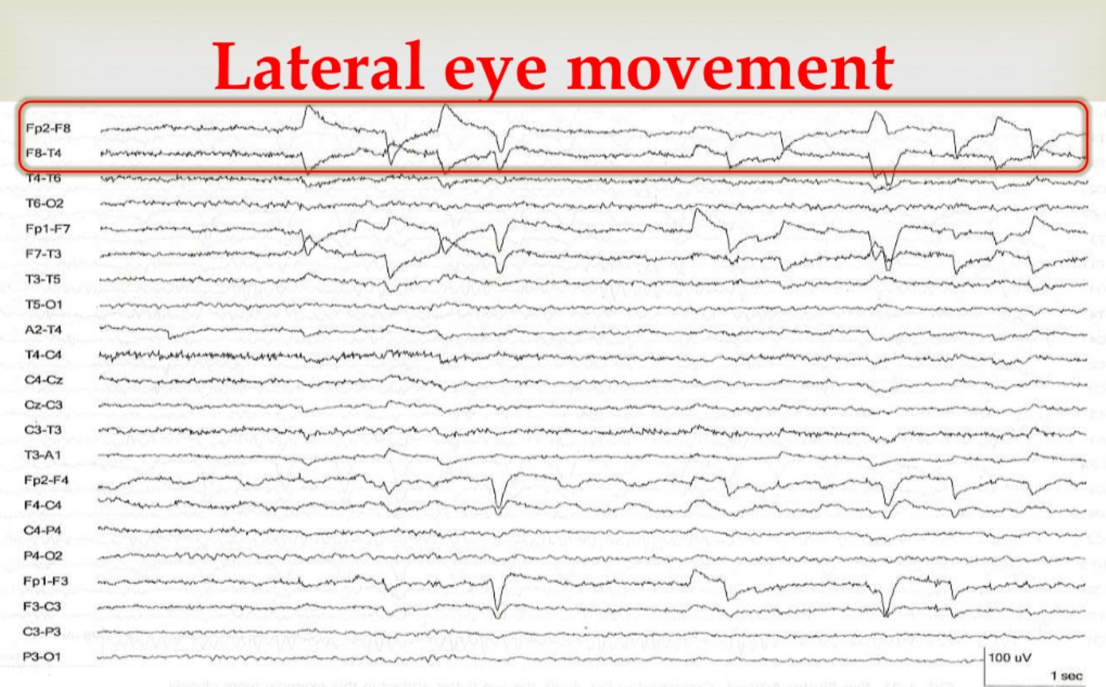

Slide 26
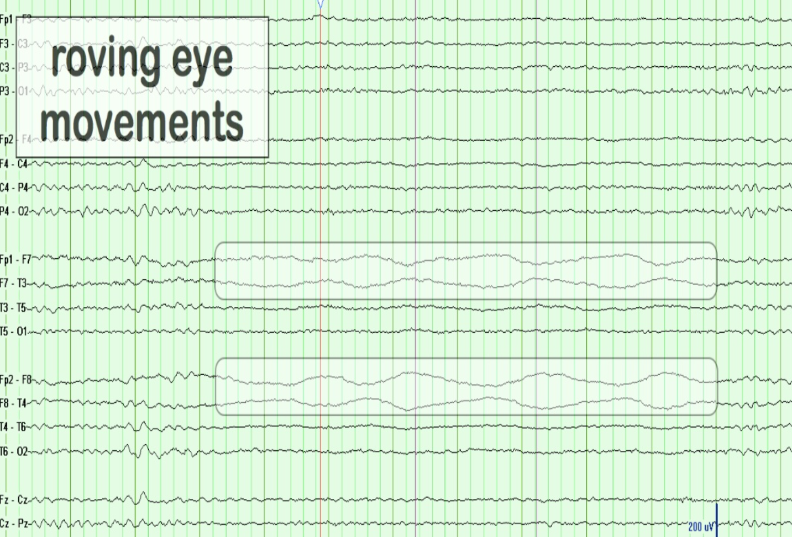

Slide 27
How To Remove Artifacts
Band pass filter takes out electrical activity outside of the range of activity the brain makes
Visual identification and removal of non-stereotypic artifacts
Use independent component analysis (ICA) to find independent components that represent stereotypic artifacts

